Slide 1
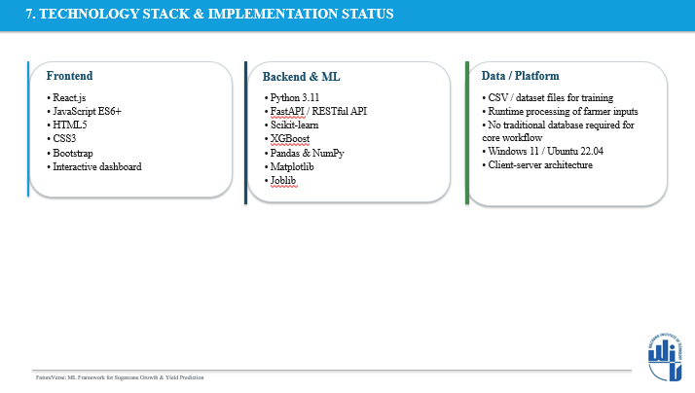
Implementation Status
Immediate Next Milestone
• Farmer-friendly UI prototype prepared
• Field Data, Farm Outlook & Recommendation screens designed
• English, Hindi & Marathi support added
• ML/API integration in progress
• Finalize dataset and train ML models
• Connect trained model with FastAPI
• Integrate predictions with recommendation engine
• End-to-end testing and deployment

